Slide 1
SharePoint Framework M7
Jenkins NS
@jenkinsns

Slide 2

Agenda
Module 7: React JS Essentials
What is React JS
What is JSX
React Components
Html Tags vs React Components
Creating Components
JavaScript Expressions
JSX Gotchas
Relationship with State Machines
Handling Component State
Adding Interactivity by means of events
Using Multiple Components
Transferring props between components
The Lifecycle of a Component
Alternative Syntax
SharePoint Framework and React

Slide 3


What is a React JS?
React is a JavaScript library created by Facebook
React is a User Interface (UI) library
React is a tool for building UI components
Building Single Page Application (SPA)
Allows reusability
Basically, react is the view layer of an MVC application.
React makes it painless to create interactive UIs. Design simple views for each state in your application and React will efficiently update and render just the right components when your data changes.

Slide 4
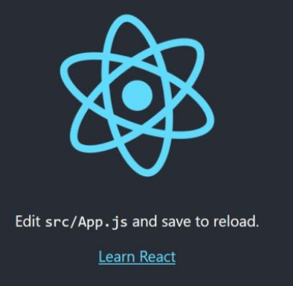
Create react app
Create React App is a comfortable environment for learning React and is the best way to start building a new single-page application in React.
npm the package manager
npm (node package manager) is the dependency/package manager you get out of the box when you install Node.js. It provides a way for developers to install packages both globally and locally.
npx the package runner
npx is also a CLI tool whose purpose is to make it easy to install and manage dependencies hosted in the npm registry.
It’s now very easy to run any sort of Node.js based executable that you would normally install via npm.
npx helps us avoid versioning, dependency issues and installing unnecessary packages that we just want to try out.
npx create-react-app my-app
cd my-app
npm start

Slide 5
What is a JSX?
JSX:
const myelement = <h1>I Love JSX!</h1>;
ReactDOM.render(myelement, document.getElementById('root’));
Without JSX
const myelement = React.createElement('h1', {}, 'I do not use JSX!');
ReactDOM.render(myelement, document.getElementById('root’));
Expressions in JSX
const myelement = <h1>React is {5 + 5} times better with JSX</h1>;
Large list
const myelement = (
<ul>
<li>Apples</li>
<li>Bananas</li>
<li>Cherries</li>
</ul>
);
Closed all tags
const myelement = <input type="text" />;
JSX is an embeddable XML-like syntax. It is meant to be transformed into valid JavaScript, though the semantics of that transformation are implementation-specific. JSX rose to popularity with the React framework but has since seen other implementations as well. TypeScript supports embedding, type checking, and compiling JSX directly to JavaScript.
Expressions in JSX
With JSX you can write expressions inside curly braces { }.

Slide 6
React Components and Props
React Components
Props
React is made up of Components
E-Books
Shopping Cart
My Orders
Purchase
Electronics
Stock

Slide 7
React Components
Create a Class Component
class Car extends React.Component { render() { return <h2>Hi, I am a Car!</h2>; } }
Components are independent and reusable bits of code. They serve the same purpose as JavaScript functions, but work in isolation and returns HTML via a render function.
Components come in two types, Class components and Function components, in this tutorial we will concentrate on Class components.
ReactDOM.render(<Car />, document.getElementById('root'));
Create a Function Component
function Car() { return <h2>Hi, I am also a Car!</h2>; }
ReactDOM.render(<Car />, document.getElementById('root'));
Component Constructor
class Car extends React.Component {
constructor() {
super();
this.state = {color: "red"}; }
render()
{ return <h2>I am a Car!</h2>; }
}
class Car extends React.Component { constructor() {
super();
this.state = {color: "red"}; }
render()
{ return <h2>I am a {this.state.color} Car!</h2>; }
}

Slide 8
React Props
Props are arguments passed into React components.
Props are passed to components via HTML attributes.
class Car extends React.Component {
render()
{
return <h2>I am a {this.props.brand}!</h2>;
}
}
class Garage extends React.Component
{
render()
{ return (
<div>
<h1>Who lives in my garage?</h1>
<Car brand="Ford" />
</div> );
} }
ReactDOM.render(<Garage />, document.getElementById('root'));

Slide 9
React State
Built in Objects
Exclusive for each component
Allows react components to change the output over time
Triggers the Components to re-enter
When the state object changes, the component re-renders.

Slide 10
Where to initialize or creating the state
The state object is initialized in the constructor
Component
constructor(props) {
super(props);
this.state = {
brand: "Ford",
model: "Mustang",
color: "red",
year: 1964
};
Constructor
Functions
Render()
{
return <div><div>; }

Slide 11
Rendering to the state object
Refer to the state object anywhere in the component by using the this.state.propertyname syntax
Component
render() {
return (
<div>
<h1>My {this.state.brand}</h1>
<p>
It is a {this.state.color}
{this.state.model}
from {this.state.year}.
</p>
</div>
);
}
Constructor
Functions
Render()
{
return <div><div>; }

Slide 12
Changing the state
To change a value in the state object, use the this.setState() method.
When a value in the state object changes, the component will re-render, meaning that the output will change according to the new value(s)
changeColor = () => {
this.setState({color: "blue"});
}
render() {
return (
<div>
<h1>My {this.state.brand}</h1>
<p>
It is a {this.state.color}
{this.state.model}
from {this.state.year}.
</p>
<button
type="button"
onClick={this.changeColor}
>Change color</button>
</div>
);
}
Component
Constructor
Functions
Render()
{
return <div><div>; }

Slide 13

React Virtual DOM
What is DOM? (actual DOM)
Document object model, it represent HTML element logical tree Structure
What is Virtual DOM?
React uses virtual DOM to enhance its performance. It uses the observable to detect state and prop changes. React uses an efficient diff algorithm to compare the versions of virtual DOM. It then makes sure that batched updates are sent to the real DOM for repainting or re-rendering of the UI.
Like the actual DOM, the Virtual DOM is a node tree that lists elements and their attributes and content as objects and properties. React's render() method creates a node tree from React components and updates this tree in response to mutations in the data model, caused by actions.

Slide 14
DOM
Virtual DOM

Slide 15
DOM
Virtual DOM

Slide 16
DOM
Virtual DOM
Diffing

Slide 17
React Components are dynamic
Properties
Public settings on components
Similar to HTML element attributes
Use to provide values into components
Use to publish events to consumers
Defined on the component via Typescript interfaces
State
State object of a component is a special property bag
React detects when the state changes & triggers a (re)render of the component
Change the state using the components setState() method
Defined on the components via Typescript interfaces

Slide 18
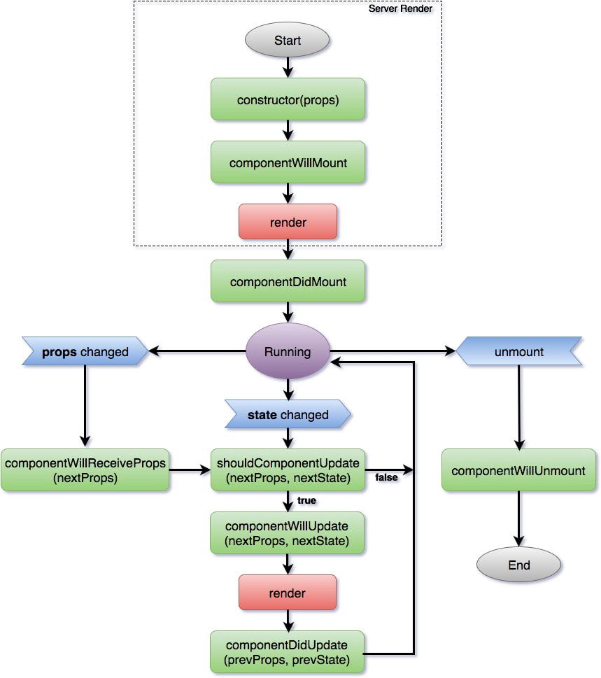
React Components life Cycle
Each component has several “lifecycle methods” that you can override to run code at particular times in the process. You can use this lifecycle methods.
Mounting
These methods are called in the following order when an instance of a component is being created and inserted into the DOM:
constructor()
render()
componentDidMount()
Updating
An update can be caused by changes to props or state. These methods are called in the following order when a component is being re-rendered:
getSnapshotBeforeUpdate()
componentDidUpdate()
Unmounting
This method is called when a component is being removed from the DOM:
componentWillUnmount()

Slide 19
Demo
Lab 13 - Create SPFx webpart using React

Slide 20
React Functional Components
Functional Component or Stateless Component
It is simple JavaScript functions that simply returns html UI
It is also called “stateless” components because they simply accept data and display them in some form that is they are mainly responsible for rendering UI.
It accept properties(props) in function and return html(JSX)
It gives solution without using state
There is no render method used in functional components.
These can be typically defined using arrow functions but can also be created with the regular function keyword.
export const FunctionalComponentExample: React.FunctionComponent<IItemProps> = (props: IItemProps) => {
}

Slide 21
React Functional Components
Lifecycle method or Lifecycle hooks in functional component
It is simple JavaScript functions that simply returns html UI
It is also called “stateless” components because they simply accept data and display them in some form that is they are mainly responsible for rendering UI.
It accept properties(props) in function and return html(JSX)
It gives solution without using state
There is no render method used in functional components.
These can be typically defined using arrow functions but can also be created with the regular function keyword.
return (
<div>
<p>Hello Functional Components
</p>
</div>

Slide 22
State Hook
Hooks are a new addition in React 16.8. They let you use state and other React features without writing a class.
Previously known these as “stateless components”.
Now the ability to use React state from these, so we prefer the name “function components”.
Hooks don’t work inside classes. But you can use them instead of writing classes.
const [price, setPrice] = useState(props.priceAmount);
<p>Price : {price}</p>

Slide 23
Demo
Lab 13 A - Create SPFx webpart using React functional Component

Slide 24
References
s

Slide 25



SPFx Info
https://docs.microsoft.com/en-us/sharepoint/dev/spfx/sharepoint-framework-overview
Twitter
@ m365pnp
Tech Community
aka.ms/sppnp-community

